Slide 1

Team 3: HARRY & HENDERSONS
Dan Davies, Stefanie Gagnon, Chris Partee, Khanh Le

Slide 2
agenda
Data overview
Data Analysis and Visualizations
findings

Slide 3

Data overview

Slide 4
Data overview
The data was derived from data provided by the Bigfoot Field Research Organization (BFRO), DataWorld.
BFRO is an organization dedicated to investigating the bigfoot / sasquatch mystery.
The dataset shows the approximate locations of bigfoot sightings and detail of sightings.

Slide 5
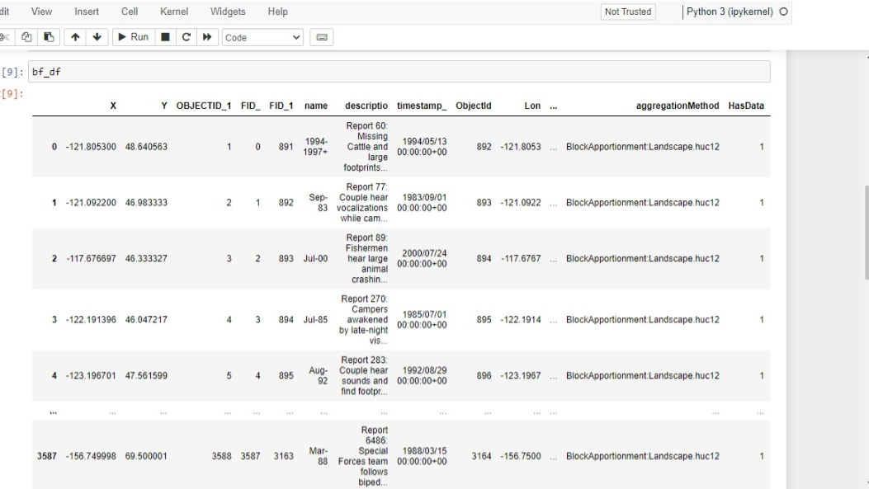

Slide 6
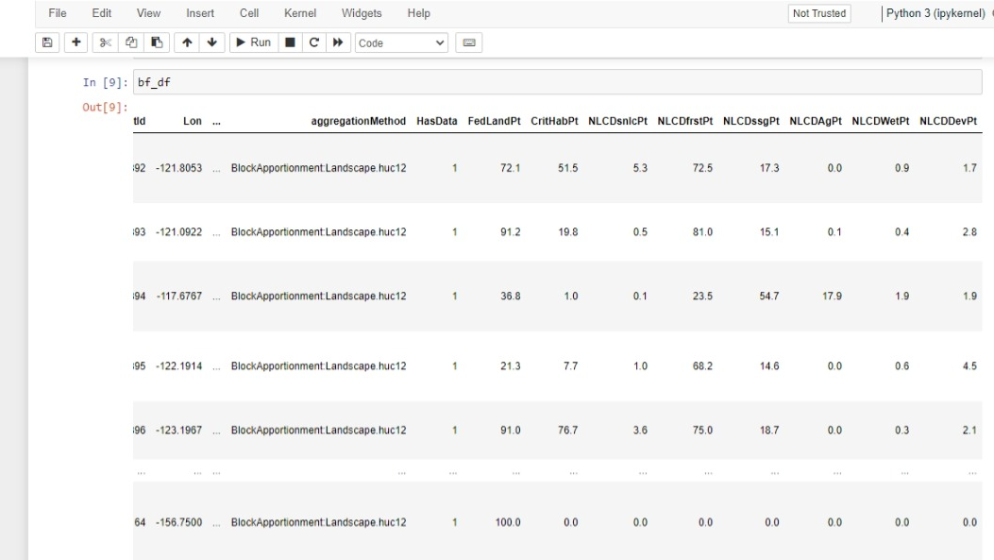

Slide 7
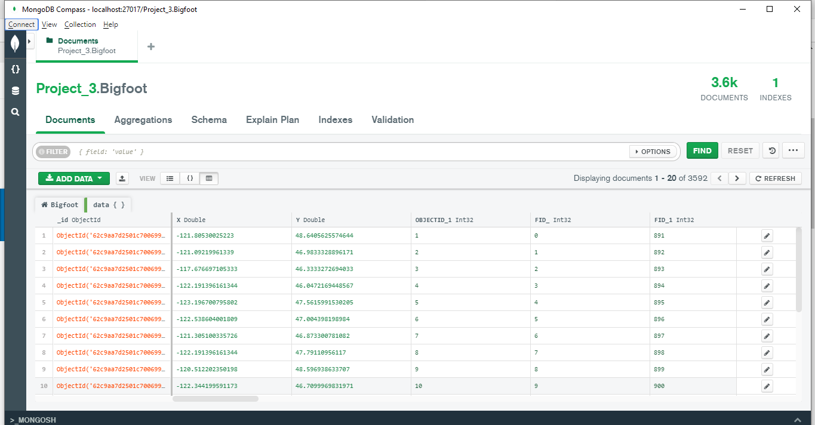

Slide 8
Data Analysis and Visualizations

Slide 9
Visualize dataset:
Get the data:
The BFRO provides sighting data in numbers of different formats. Use the CSV dataset to convert database.
The online article “The 10 Most Convincing Bigfoot Sightings” from The Outside journalism website.
Import & Visualize the data:
Create a map using Leaflet that plots the sightings from the database based on their longitude and latitude, including 3 base maps: Satellite, Street, Topographical.
The data markers reflect the numbers of sightings.
The popups provide detail information about the sighting when a marker is clicked.
Plotting bar char and line chart show sighting distribution by class and by year.
Scraping bigfoot image from https://cdn.pixabay.com/
Scraping news and images from www.outsideonline.com

Slide 10
Legend shows type of class:
Class A: reports involve clear sightings in circumstances where misinterpretation or misidentification of other animals can be ruled out with greater confidence.
Class B: incidents where a possible sasquatch was observed at a great distance or in poor lighting conditions and incidents in any other circumstance that did not afford a clear view of the subject.
Class C: most second-hand reports, or any third-hand reports, or stories with an untraceable sources.

Slide 11
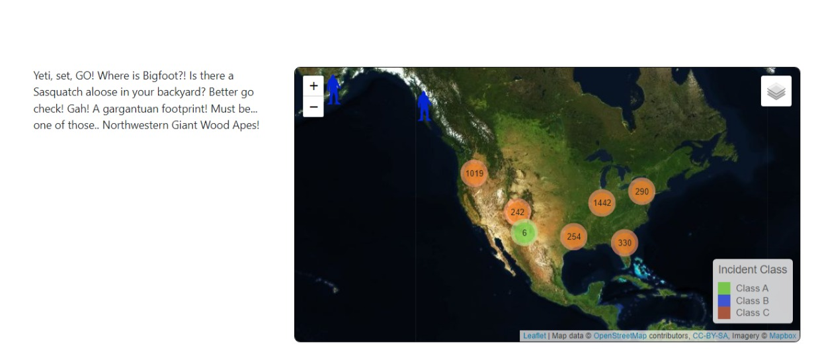
Data Analysis and Visualizations

Slide 12
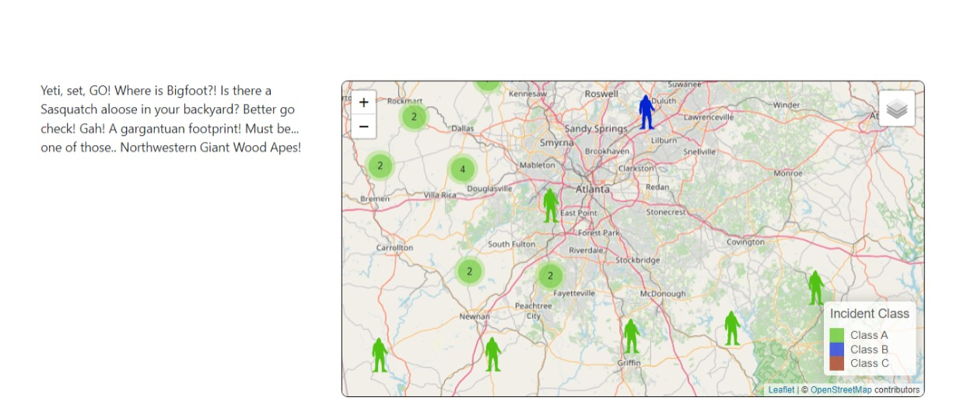
Data Analysis and Visualizations

Slide 13
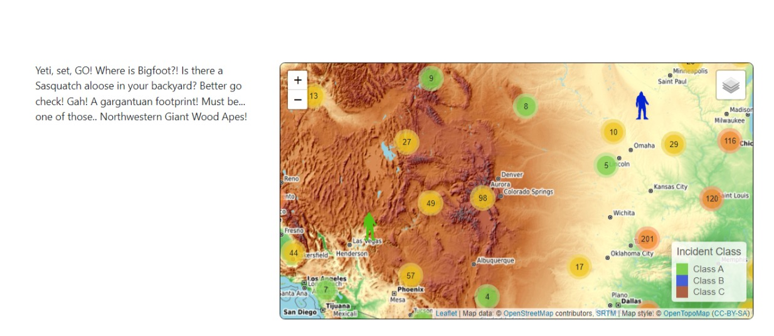
Data Analysis and Visualizations

Slide 14
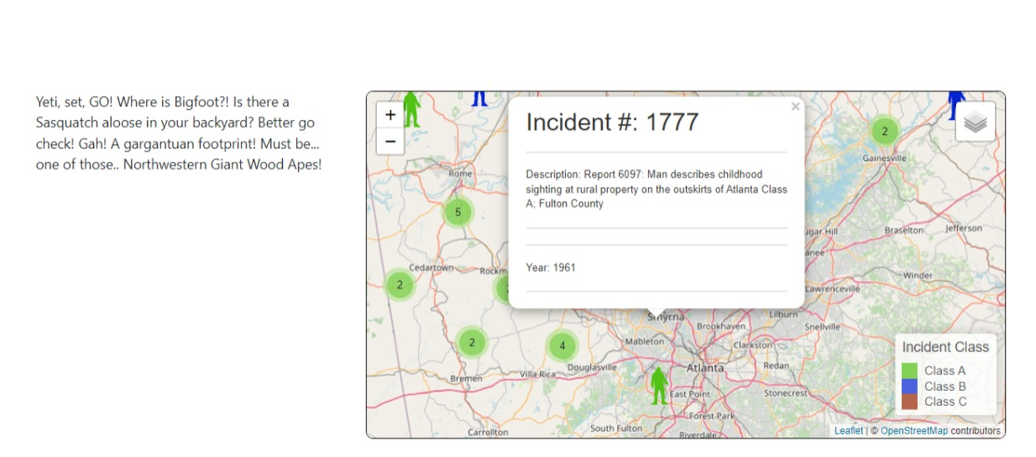
Data Analysis and Visualizations

Slide 15
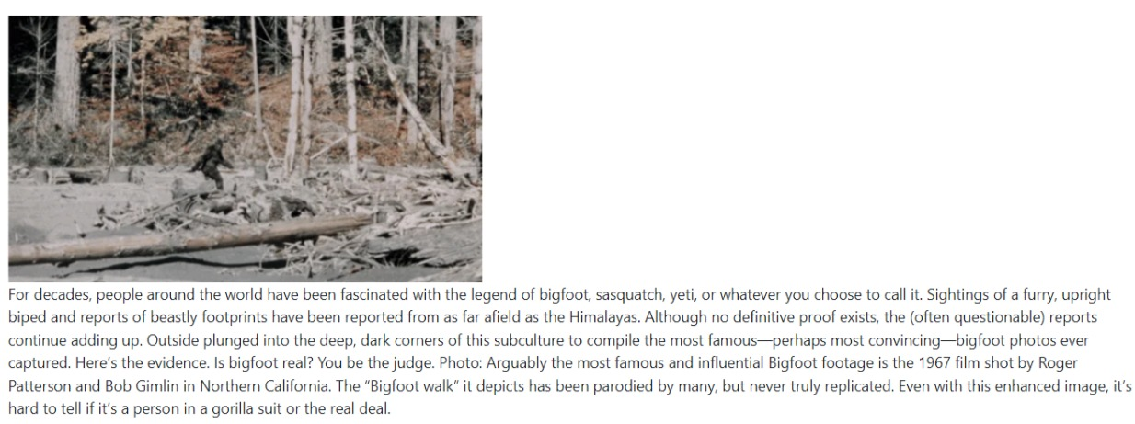
Data Analysis and Visualizations

Slide 16
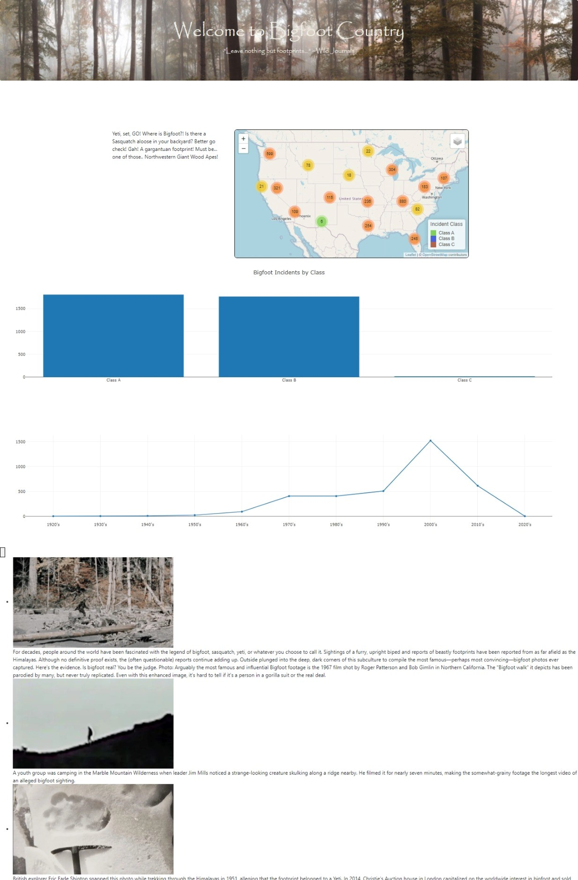
Data Analysis and Visualizations

Slide 17
findings

Slide 18
findings
States which are high density of sasquatches.
Distribution of bigfoot sightings by year
Distribution of bigfoot sightings by class.

Slide 19
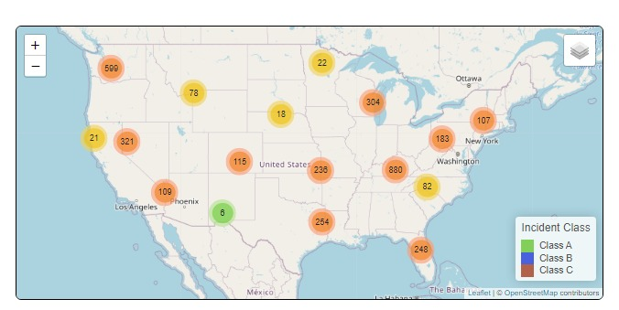
States which are high density of sasquatches

Slide 20
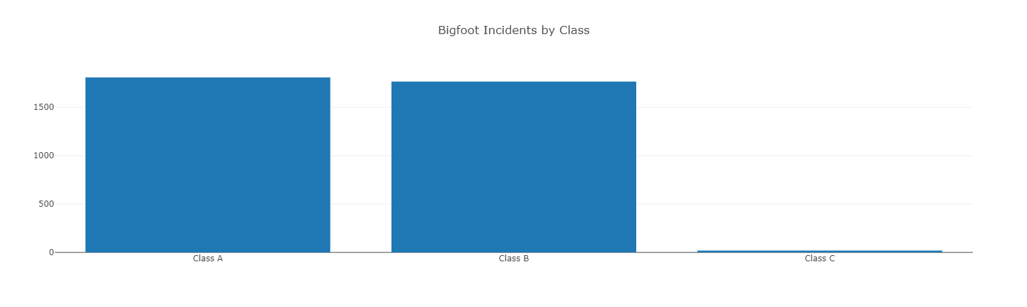
Distribution of bigfoot sightings by class

Slide 21
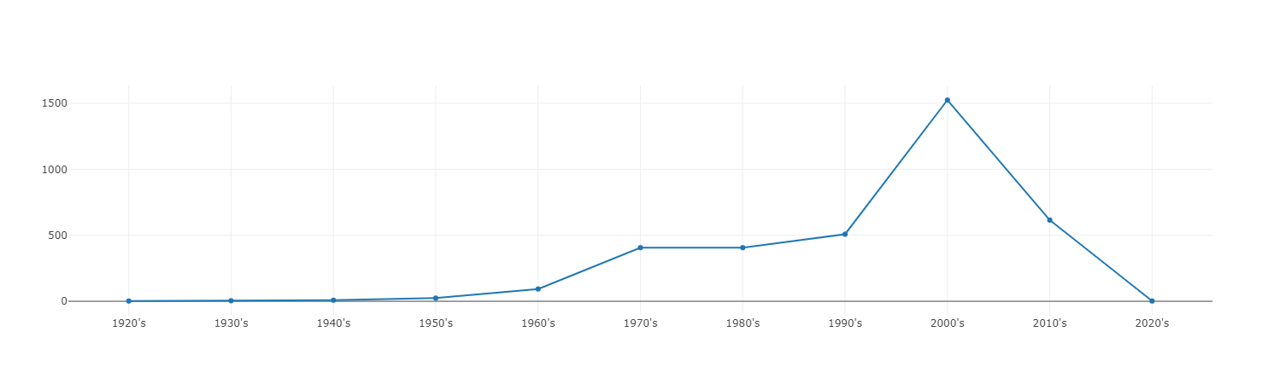
Distribution of bigfoot sightings by year

Slide 22
questions for further exploration
Map show areas with a high concentration of sightings using a clustering .

Slide 23
References:
https://hub.arcgis.com/datasets/TrainingServices::-bigfoot-sightings/explore?location=27.848424%2C-103.774481%2C4.00
https://data.world/timothyrenner/bfro-sightings-data
https://cdn.pixabay.com/photo/2022/01/14/04/02/bigfoot-6936421__340.png
https://www.outsideonline.com/gallery/10-most-convincing-bigfoot-sightings/

Slide 24
Where do you think you can see BIGFOOT?
… in your BACKYARD?

Slide 25
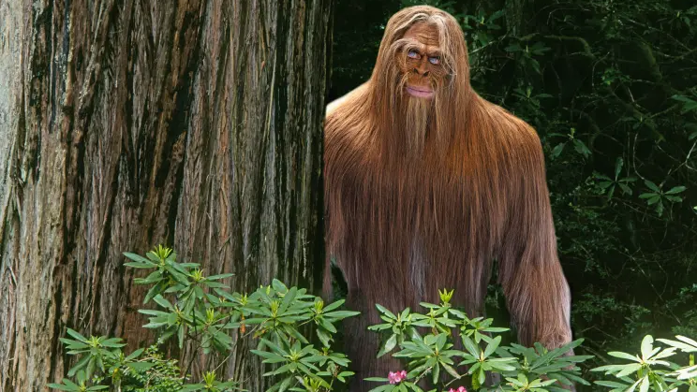
“HOPE TO SEE YOU TONIGHT”
THANK YOU!

